Slide 1

Simplify Design Specification
Praharsh R Dubey 2738037
Vikram Baruah 2795941
Yin Long 2751099
Zhaobo Guo 2815951
Yifan Guo 2721370

Slide 2



Agenda
Overview
Specification
High-Level System Architecture
ER Diagram
Site Map
Wireframes
Contribution List

Slide 3

Overview
Simplify is the platform to learn about complexities in a simple manner. A place to learn and teach.
The web application provides students and tutors an open ground to exchange knowledge without any hassle. The application gives any enthusiast the ability to either become a student or a tutor and share their knowledge with like minded individuals.
The focal point is that the platform is open source, i.e. open for the world to share and gain knowledge.

Slide 4
Specification
Alan, 37
Tutor
Daniel, 21
Student
Tutor should be able to login or register using google authentication or a registration form.
Tutor should be able to register as a tutor.
Tutor should be able to see their courses and be able to add new courses.
Tutor should be able to add a description for a new course.
Tutor should be able to publish course materials including slides, pdfs, images and video.
Tutor should have access to forums for providing important updates regarding the course and for clearing doubts.
Student should be able to login or register using google authentication or a registration form.
Student should be able to register as a student.
The platform should be able to distinguish between the tutor and the student, with access being given to the student user for only the student specific pages.
Student should be able to access all the course material.
Student should be able to submit course work provided under a given course.
Student should be able to enrol in more than one course at a given time.
Student should have access to forums for discussion and posting questions.

Slide 5
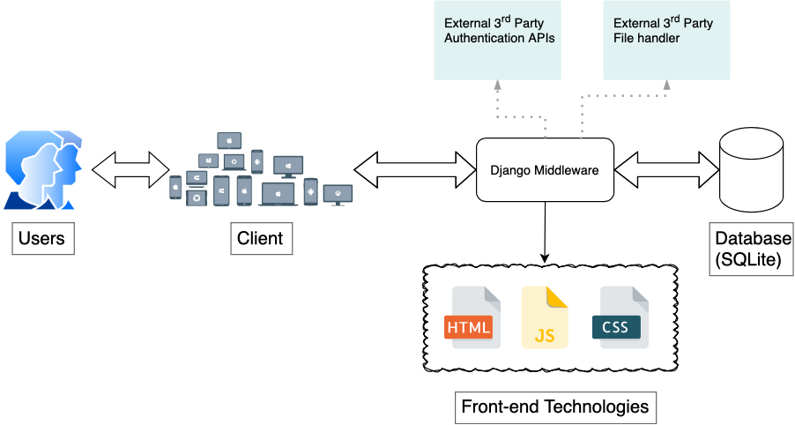
High-Level System Architecture

Slide 6
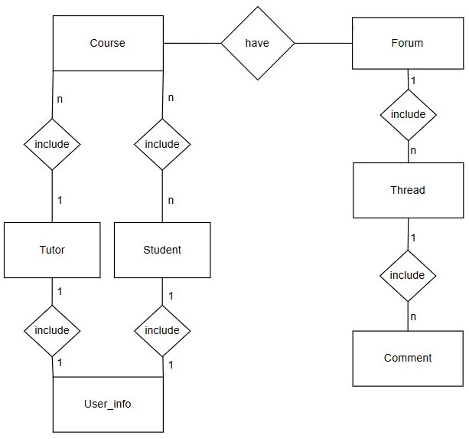
ER Diagram

Slide 7
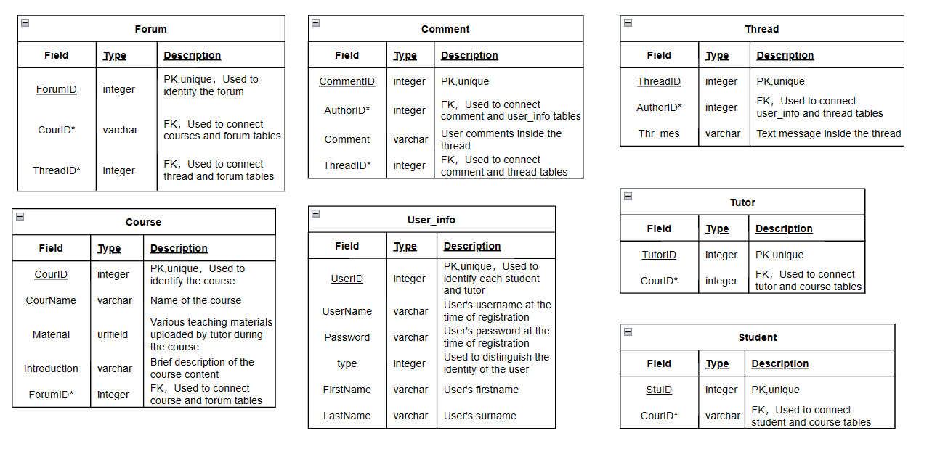
ER Diagram Description

Slide 8
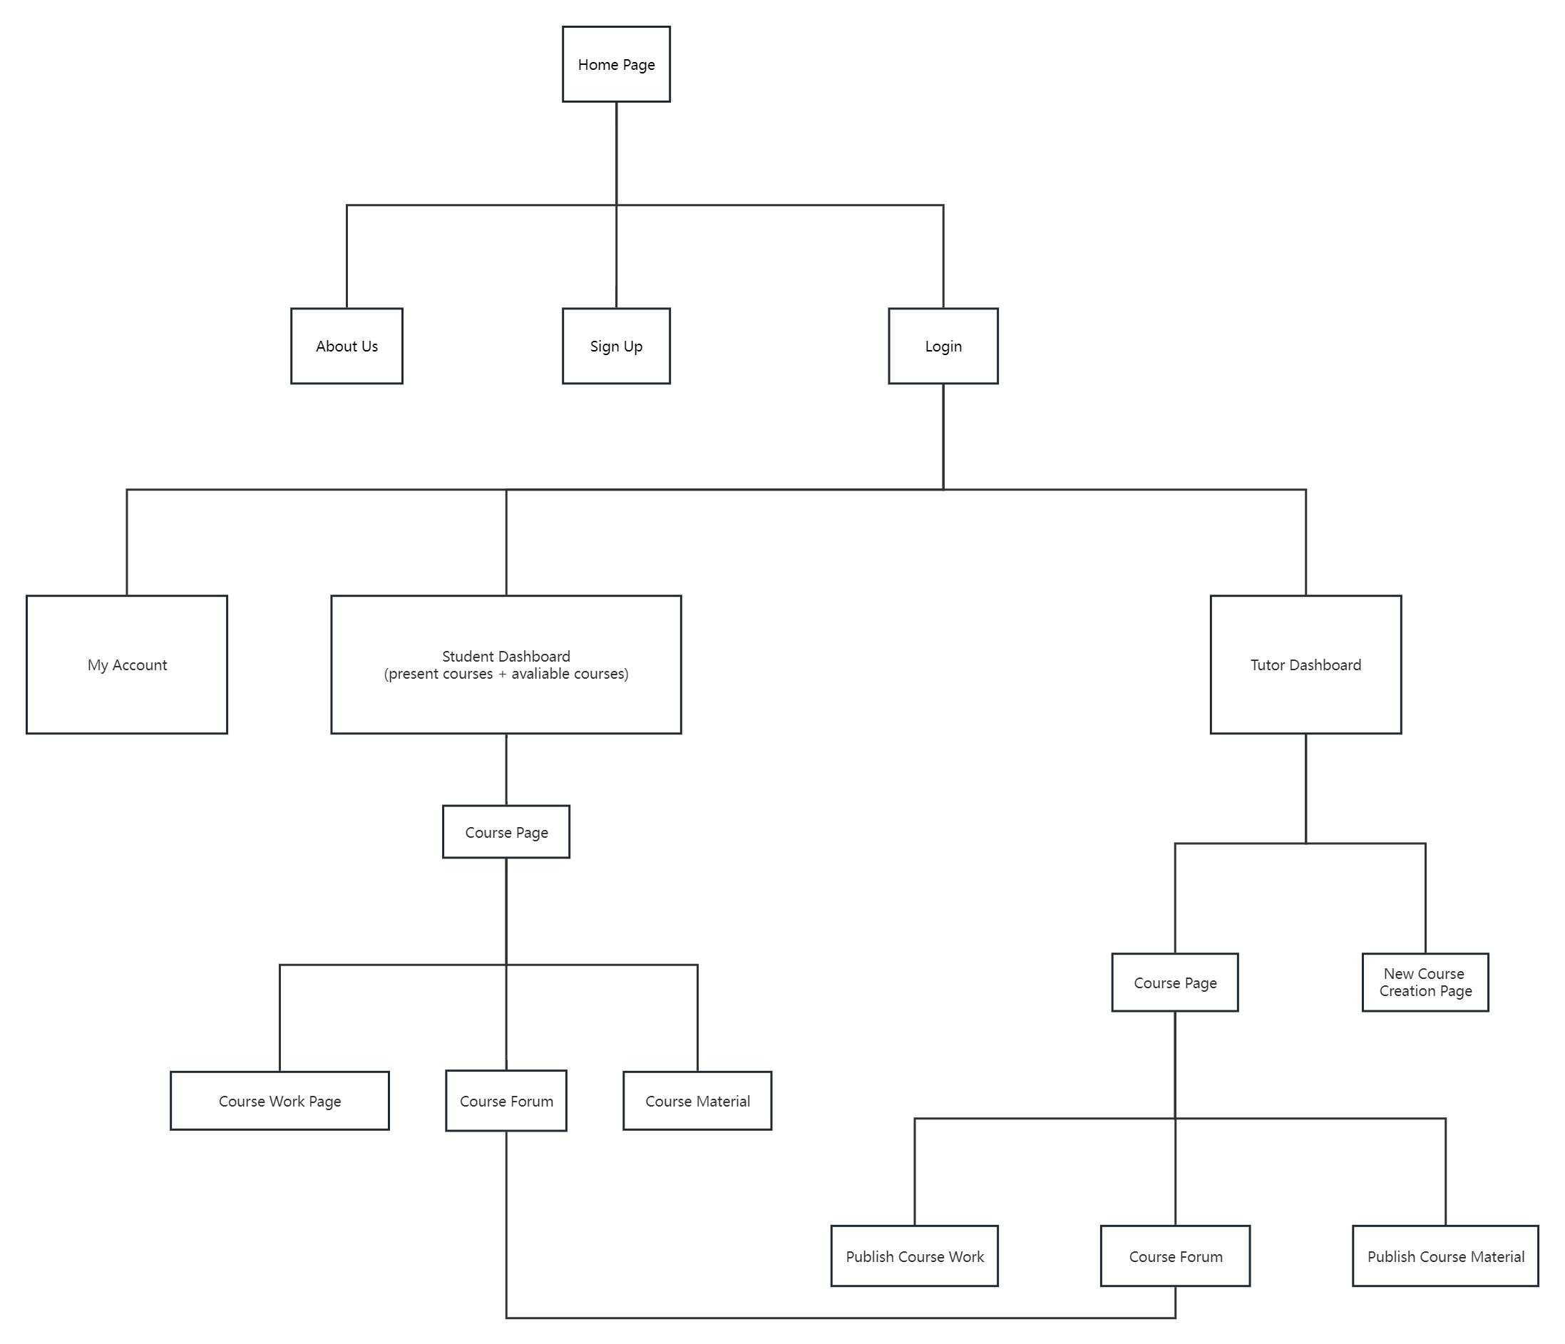
Site Map

Slide 9

Wireframes
Home Page
Student Dashboard
Tutor Dahboard
Course Page (Student)
New Course Page (Tutor)

Slide 10
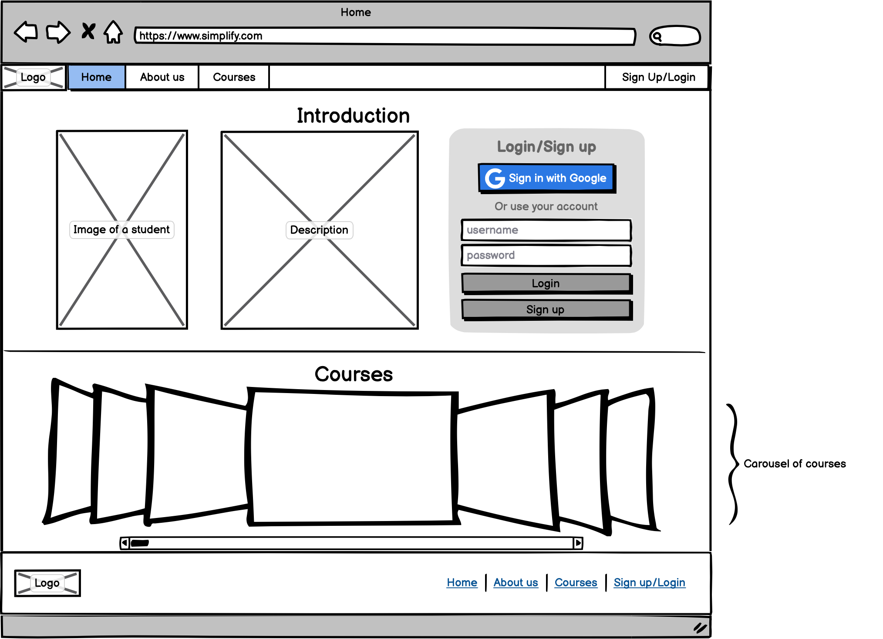
10

Slide 11
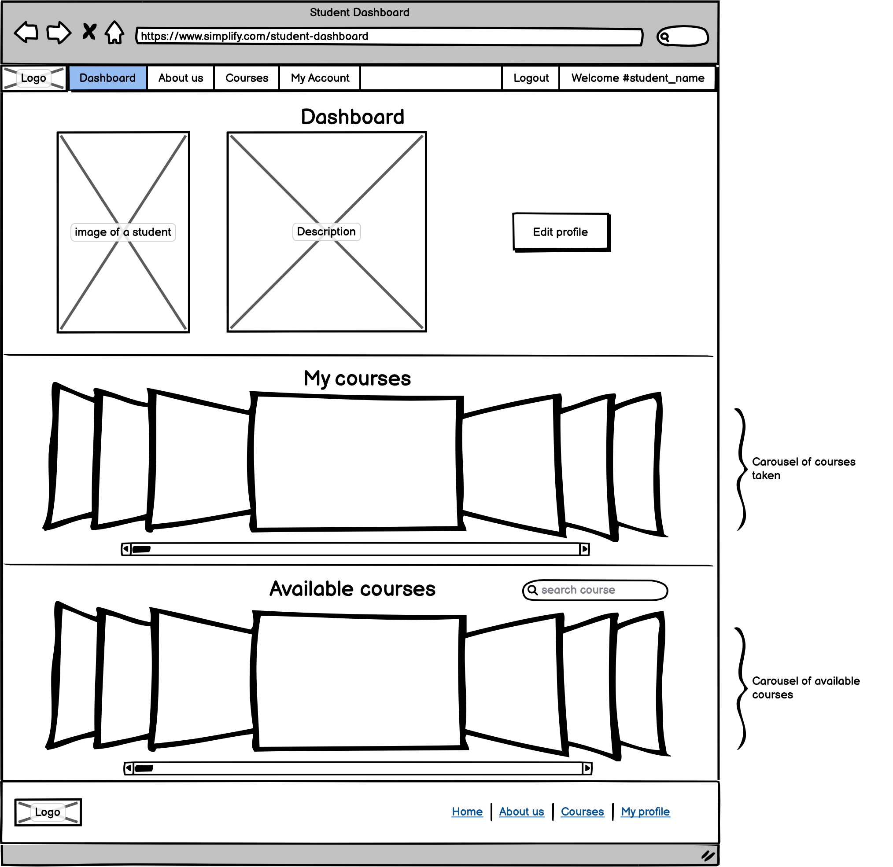
2023
11

Slide 12
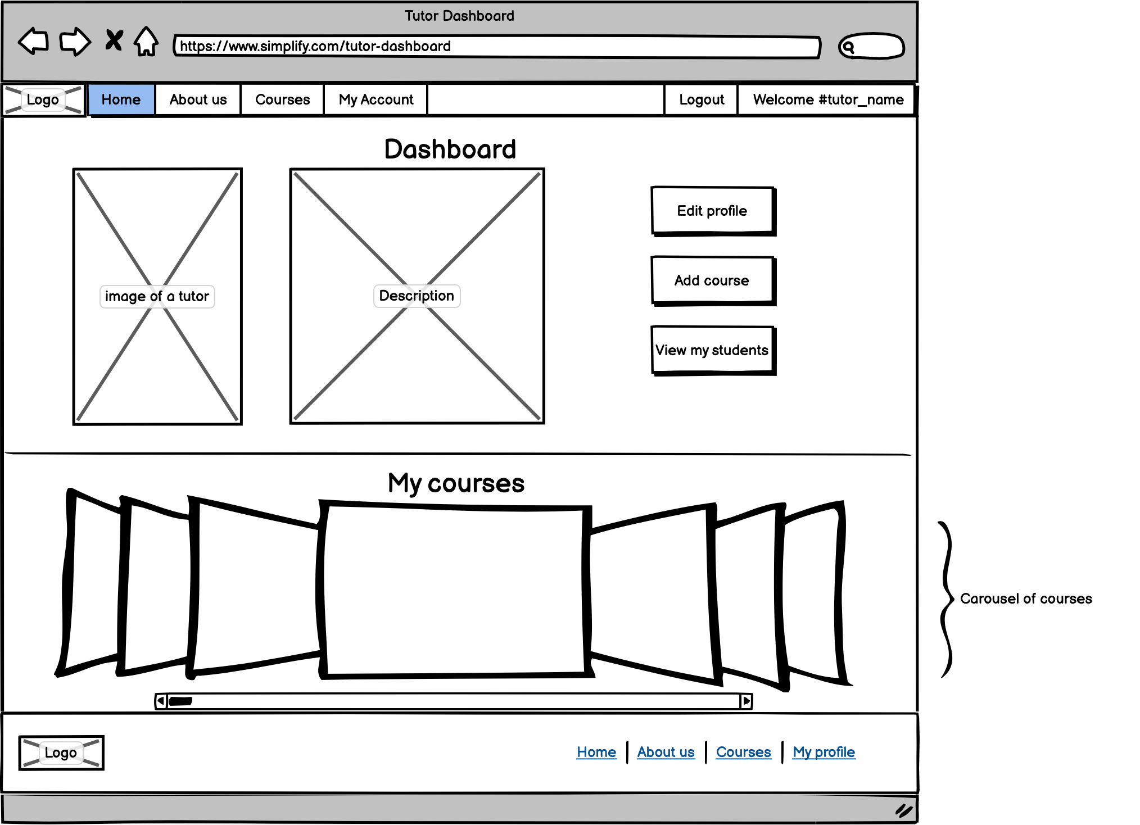

Slide 13
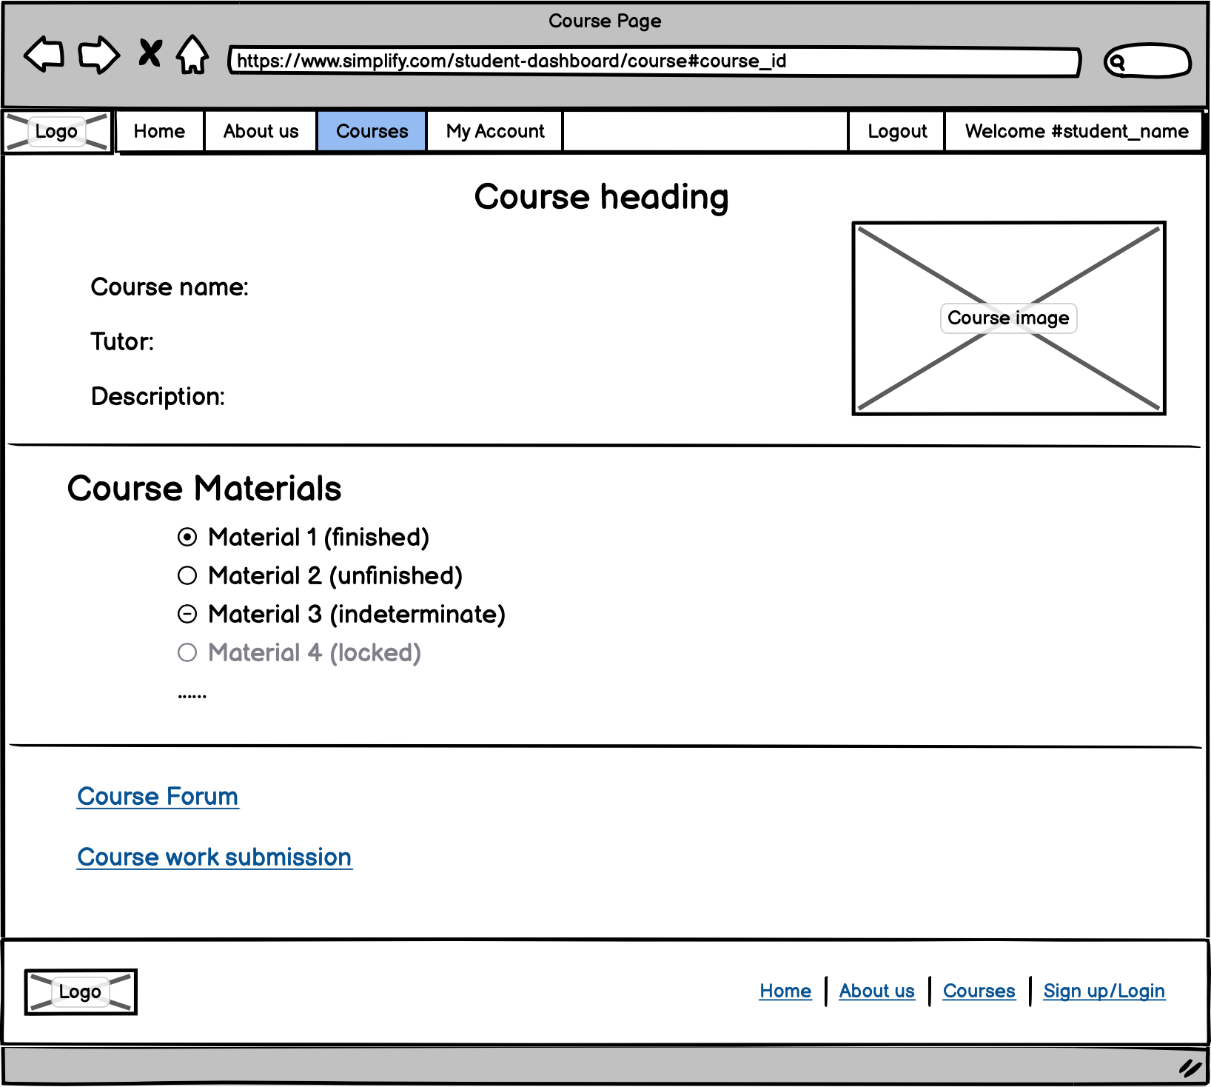

Slide 14
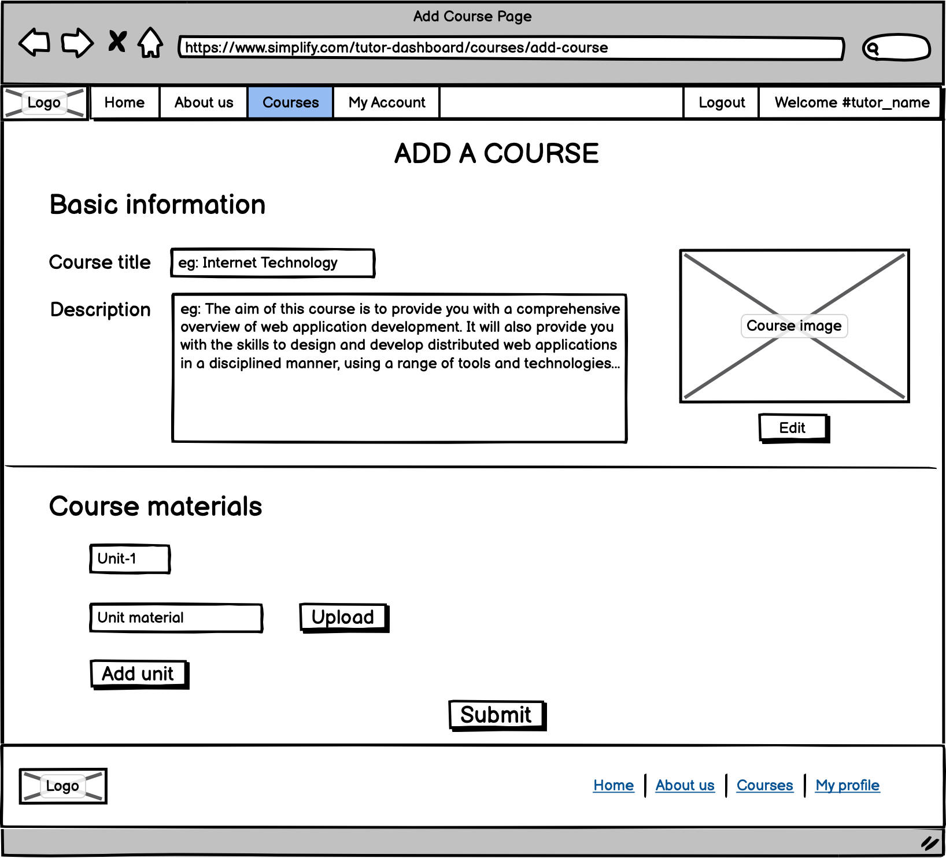

Slide 15
Appendix: Contribution
Name | Student ID | Contribution % | Contributed in
Praharsh R Dubey | 2738037 | 28% | Overview, Specification, High-Level System Architecture, ER Diagram, Site Map and Wireframes
Vikram Baruah | 2795941 | 18% | Specification
Yin Long | 2751099 | 18% | ER Diagram
Zhaobo Guo | 2815951 | 18% | Site Map
Yifan Guo | 2721370 | 18% | Wireframes

Slide 16


Thank you

